Slide 1

White Paper on Hydrogen in Kenya
—
Calculation results

Slide 2
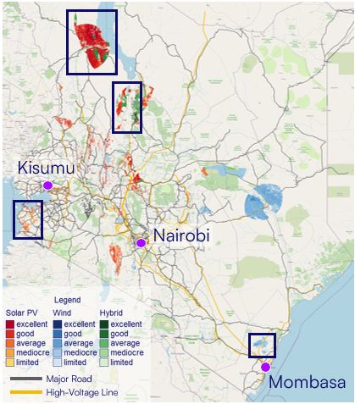
Assumptions
Renewable electricity generation → reference year to be checked
Turkana central (Hybrid)
Wind: 41.70 % capacity factor PV: 21.10 % capacity factor
Turkana south (Hybrid)
Wind: 60.27 % capacity factor PV: 20.23 % capacity factor
Kisumu (PV)
Wind: 12.04 % capacity factor PV: 19.77 % capacity factor
Mombasa (Wind)
Wind: 40.40 % capacity factor PV: 17.61 % capacity factor

Slide 3
Assumptions
Techno-economic parameters
Component | Scenario |  | CAPEX |  |  |  | OPEX |  | Lifetime |  | Efficiency
Wind |  |  | 1,238,092 | €/MW |  |  | 2.8% | of CAPEX | 25 | years
PV |  |  | 561,068 | €/MW |  |  | 1.7% | of CAPEX | 25 | years
Battery |  |  | 300,000 | €/MWh |  |  | 1.50% | of CAPEX | 15 | years | 95%
Substation |  |  | 48,928 | €/MW |  |  |  |  | 40 | years | 99.5%
Power line | 10 | MW | 40,000 | €/km |  |  | 0.7% | of CAPEX | 40 | years | Losses: 1.1% / 100 km
 | 100 | MW | 185,000 | €/km
 | 500 | MW | 270,000 | €/km
Electrolysis (PEM) | 10 | MW | 1,500,000 | €/MW | 55 % | stack share | 2% | of CAPEX | 90,000 | hours | 67%
 | 100 | MW | 1,000,000 | €/MW | 65 % | stack share
 | 500 | MW | 750,000 | €/MW | 71 % | stack share
Water treatment |  |  | 9.5 | €/(tH2O/a) |  |  | 4% | of CAPEX | 30 | years | 4.5 kWh/m³H2O
Hydrogen storage |  |  | Size dependent | €/t |  |  | 1% | of CAPEX | 30 | years
NH3 synthesis | 1.1 | t/h | 9,095,994 | €/(tNH3/h) |  |  | 2% | of CAPEX | 30 | years | 0.44 MWh/tNH3
 | 11.3 | t/h | 4,234,968 | €/(tNH3/h)
 | 56.6 | t/h | 2,481,945 | €/(tNH3/h)
Air separation unit |  |  | 1,450,000 | €/(tN2/h) |  |  | 2% | of CAPEX | 30 | years | 0.2 MWh/tNH3

Slide 4
Assumptions
Scenarios
Scenario |  |  |  | Transmission line |  | Grid
 |  |  |  | km (new) | km (grid) | €/MWh
1a | Turkana central |  | 10 MW | 170 | 400 | -
1b | Wind | 41.70% | 100 MW | 170 | 400 | -
1c | PV | 21.10% | 500 MW | 570 | 0 | -
2a | Turkana south |  | 10 MW | 40 | 400 | -
2b | Wind | 60.27% | 100 MW | 40 | 400 | -
2c | PV | 20.23% | 500 MW | 440 | 0 | -
2ba | Supplementary supply from grid / geothermal PPA (auxiliaries only) |  | 100 MW | 40 | 400 | 65
2bb | Supplementary supply from grid / geothermal PPA |  | 100 MW | 40 | 400 | 65
2bc | Transport of ammonia |  | 100 MW | 40 |  | -
3a | Kisumu |  | 10 MW | 150 | 0 | -
3b | Wind | 12.04% | 100 MW | 150 | 0 | -
3c | PV | 19.77% | 500 MW | 150 | 0 | -
4a | Mombasa |  | 10 MW | 40 | 50 | -
4b | Wind | 40.40% | 100 MW | 40 | 50 | -
4c | PV | 17.16% | 500 MW | 40 | 50 | -

Slide 5
Results
10 MW scenario

Slide 6
Results
100 MW scenario

Slide 7
Results
500 MW scenario

Slide 8
Results
Turkana south

Slide 9
Results
Turkana south grid configuration / use of geothermal energy
Grid / geothermal energy
Power: 0 MWp
Energy: 0 MWh/year
Grid / geothermal energy
Power: 6.88 MWp
Energy: 1,321 MWh/year
Grid / geothermal energy
Power: 67.35 MWp
Energy: 159,876 MWh/year

Slide 10
Results
Renewable installation
 | Wind CF | PV CF
Kisumu | 12.04% | 19.77%
Mombasa | 40.40% | 17.16%
Turkana central | 41.70% | 21.10%
Turkana south | 60.27% | 20.23%

Slide 11
Outlook
Next steps
Reference year
Check if the used time series are from a year that can be considered representative for the respective RE sites
„Transport of electrons vs transport of molecules“
Challenge the set-up fot the 100 MW scenario in Turkana South by comparing the transport of electricity with the transport of the final product
Option 1: PtX production in Nairobi, electricity transmission from RE site to PtX production site (~ 440 km)
Option 2; PtX production near RE site, transport of ammonia to Nairobi

